Slide 1
FELARE: Fair Scheduling of Machine Learning Tasks on Heterogeneous Edge Systems
Ali Mokhtari¹, MD Abir Hossen², Pooyan Jamshidi², Mohsen Amini Salehi¹
July 2022
Notes:
Performance Modeling of Scheduling Policy in Heterogeneous Computing Systems(??)

Slide 2
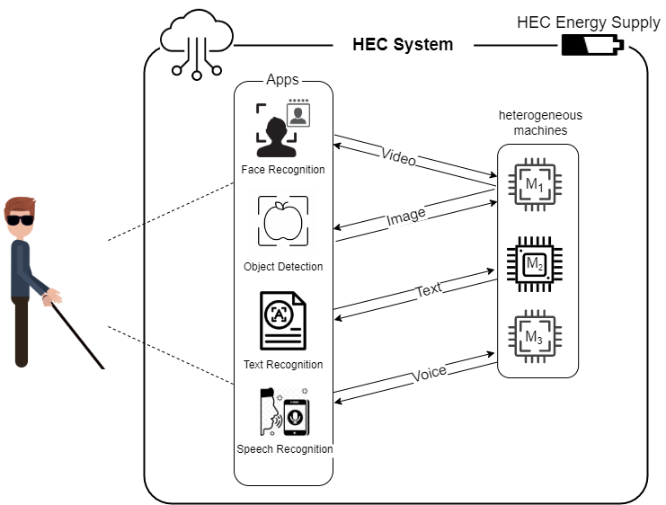
Machine Learning (ML) Tasks in Smart Edge Computing Systems
The system should serve the user’s request withing a short latency
The system should serve ML tasks concurrently and continuously
IoT-based smart systems offer multiple smart services

Slide 3
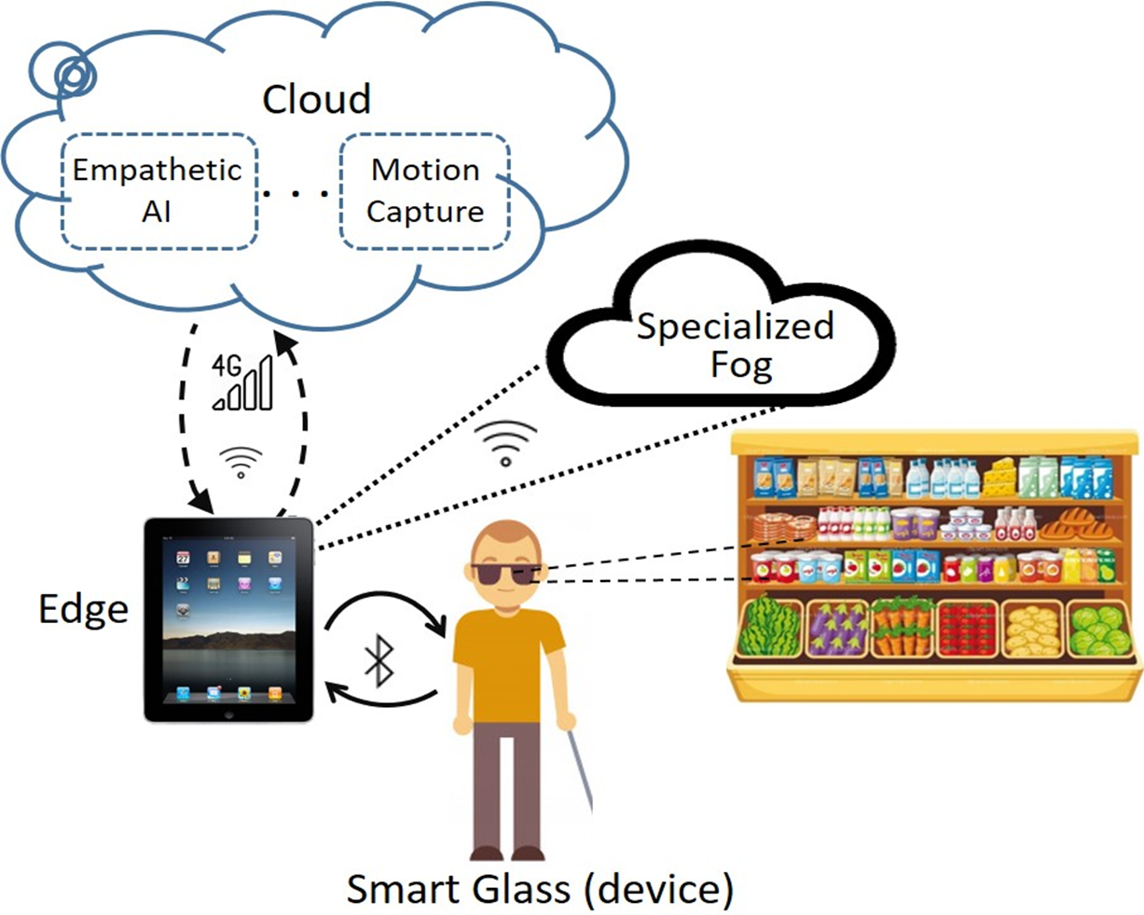
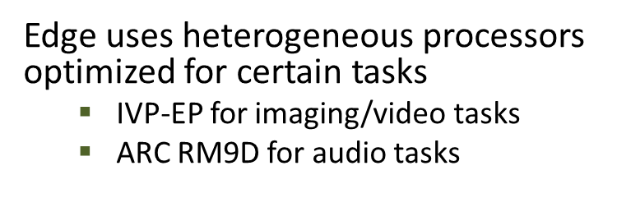
Motivation: SmartSight Project

Slide 4
Heterogeneous Edge Computing (HEC) Systems
Latency-Sensitive ML Tasks
Multiple Concurrent and Continuous ML Tasks
Heterogeneous Edge Systems
Process ML tasks in user’s proximity
Different processing units optimized for ML tasks
Resource-Limited
(Energy and Computing)

Slide 5
Problem Statement
Allocating tasks to edge processors affects the latency and energy objectives
Allocating user requests to the fastest machine (with higher energy consumption) depletes the battery quickly and runs the system unusable
Resource allocation decisions must also be fair across concurrent services
Energy and latency objectives cannot be fulfilled by making the system biased towards specific task types

Slide 6
Problem Statement
How to design a fair resource allocation method for tasks such that the on-time
task completion rate is maximized within the energy constraint
of the HEC system?

Slide 7
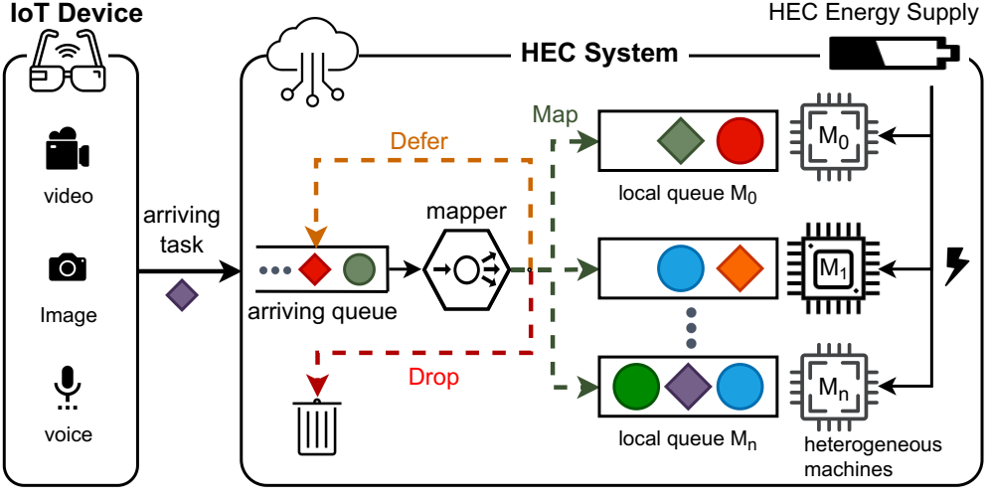
Heterogeneous Edge Computing (HEC) System: Overview
The local queue on each machine is to fetch the required data before the execution
a single-user HEC system is employed to host multiple ML applications
tasks with various modalities are queued upon arrival.
Sensors of the system capture multi-modal input (video, image, and voice) and form latency-sensitive task requests
Heterogeneous machines that are optimized for fast execution of certain ML task types
mapper uses a mapping heuristics to map, defer, or drop task
Tasks are independent with hard deadline

Slide 8
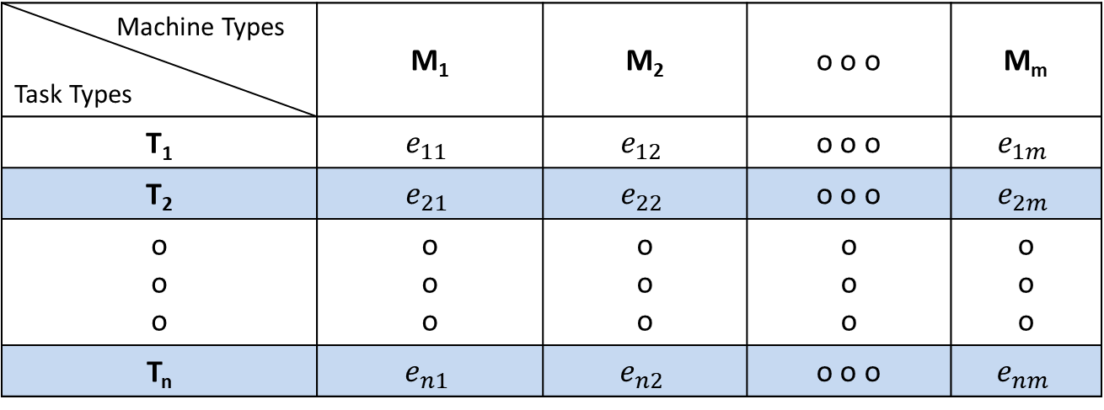
System Model
EET (Expected Execution Time) Matrix
Machine types
Machine Types Task Types | M₁ | M₂ | o o o | M_{m}
T₁ | $$e_{11}$$ | $$e_{12}$$ | o o o | $$e_{1m}$$
T₂ | $$e_{21}$$ | $$e_{22}$$ | o o o | $$e_{2m}$$
o o o | o o o | o o o | o o o | o o o
T_{n} | $$e_{n1}$$ | $$e_{n2}$$ | o o o | $$e_{nm}$$
Task types
Expected Execution Time (EET) of task type T₁ on machine type M₂

Slide 9
ELARE: Energy- and Latency-Aware Resource Allocation in HEC
The energy of edge is wasted in two ways:
Unsuccessful task completion
Mapping a task to a machine where the task misses its deadline
Inefficient resource allocation (overkill)
The extra energy consumed (wasted) by a machine to complete a task that could be otherwise successfully completed on another machine with less consumed energy
To mitigate the energy wastage, we propose a two-phase Latency- and Energy-aware resource allocation method, called ELARE

Slide 10
ELARE: Energy- and Latency-Aware Resource Allocation in HEC
To mitigate the wasted energy due to unsuccessful allocation:
in Phase1: Identify and Defer unlikely-to-succeed tasks from arriving queue
if a task misses its deadline, Drop it
To mitigate the wasted energy due to overkill allocation:
the mapper minimizes the energy consumption in its mapping decisions

Slide 11
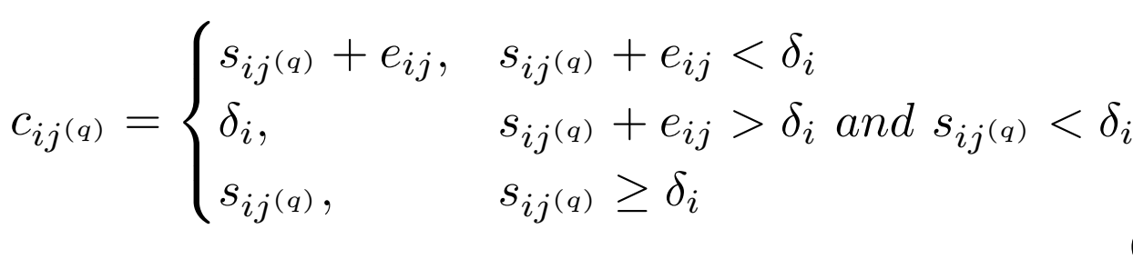
ELARE- Phase (I): Infeasible Pairs
To determine the feasibility of a [task; machine] pair, the expected completion time of the task on the machine is required
In case (II) and (III), the [task, machine] pair is identified as an infeasible pair
Completion time of task “i” on machine “j”
(I) Task successfully completed before deadline
deadline of task “i”
(II) Task started before deadline but missed the deadline
(III) Task missed the deadline before starting execution
(I)
(II)
(III)
Start time
Expected execution time of task “i” on machine “j”

Slide 12
ELARE: Energy-Efficient Scheduling
In Phase-I, the feasible [task; machine] pair that incurs minimum energy usage is singled out and considered as the feasible and efficient pair for that task
It is possible that multiple tasks become feasible for a machine in the system
Phase-II of the ELARE heuristic is responsible to map the feasible pair that incurs the minimum expected energy consumption

Slide 13
Fairness Across Task Types
A resource allocation method is fair if it is unbiased in allocating resources to the tasks of the same priority
The resource allocation should not prioritize task types based on their execution time or any other system level metric other than those explicitly defined by the user
We assumed no precedence across task types in in this work

Slide 14
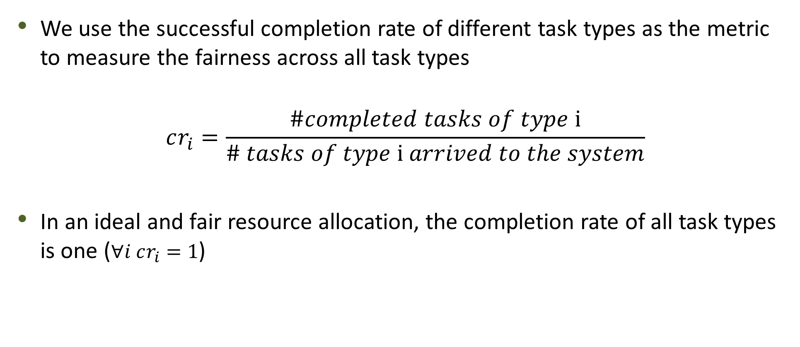
Fairness in Completing Task Types
We use the successful completion rate of different task types as the metric to measure the fairness across all task types
$$cr_{i}=\frac{\#completed tasks of type \text{i}}{\# tasks of type \text{i} arrived to the system}$$
In an ideal and fair resource allocation, the completion rate of all task types is one ($∀i cr_{i}=1$)
Completion rate of task type “i”

Slide 15
Fairness in Completing Task Types
To quantify the fairness, we continuously monitor the task types completion rates
An observed completion rate distribution could be categorized as:
Co-existence of high and low values for task type completion rates
Similar but low completion rate values for all task types
Similar and high completion rates for all the task types
The first observation is the situation where the mapping favors certain task types:
improving the fairness is translated as transitioning from category (i) to (iii)

Slide 16
Fairness in Completing Task Types
Category (I)
Category (III)
Fairness
Task Type Completion rate
Task Types

Slide 17
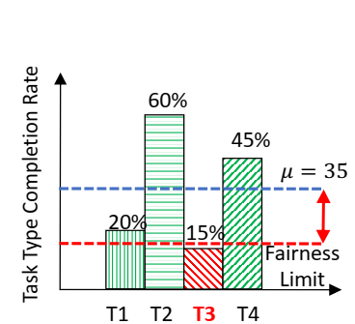
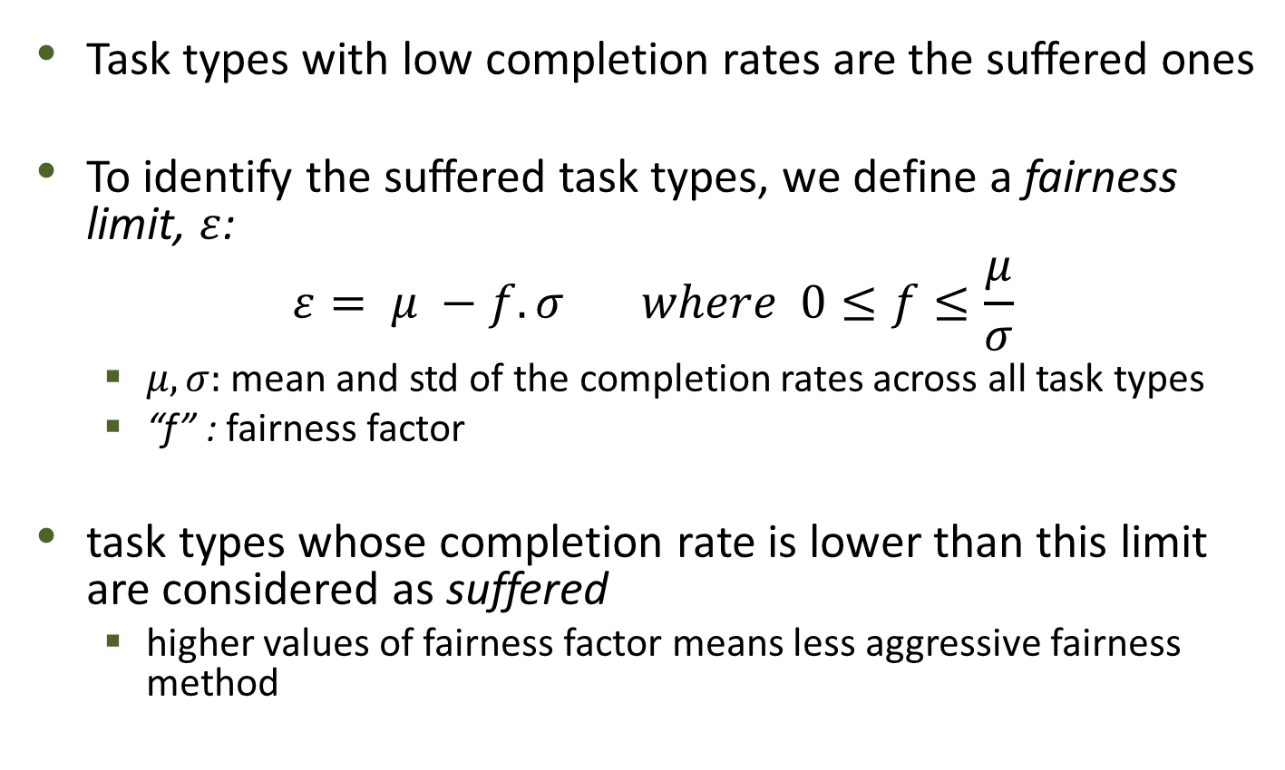

Suffered Task Types
Task types with low completion rates are the suffered ones
To identify the suffered task types, we define a fairness limit, $ε$:
$$ε= μ −f. σ where 0≤f≤\frac{μ}{σ}$$
$μ,σ:$ mean and std of the completion rates across all task types
“f” : fairness factor
task types whose completion rate is lower than this limit are considered as suffered
higher values of fairness factor means less aggressive fairness method
$$f. σ$$
Suffered task type

Slide 18
FELARE: Fair ELARE
Extended version of the ELARE heuristic and is Fair Energy- and Latency-Aware Resource Allocation (FELARE)
FELARE follows the following approaches to address the fairness:
Prioritizing the suffered tasks in the mapping events
Leveraging task dropping for non-suffered tasks in favor of infeasible suffered tasks to make them feasible
The pending tasks in the local queue of the fastest (best-matching) machine are dropped one-at-a-time, until the suffered task becomes feasible on that machine
These two strategies ultimately enhance the completion rate for the suffered tasks and gradually diminishes the dispersion in the completion rates of the task types

Slide 19
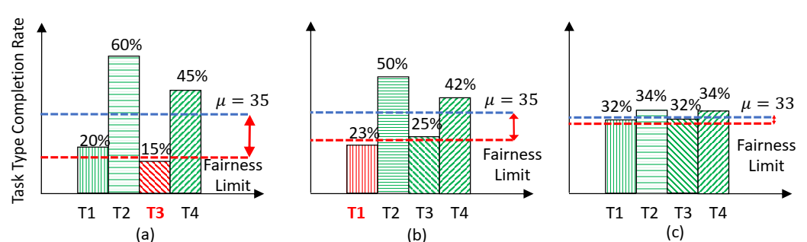
FELARE: Fair ELARE
The completion rate variance is diminishing from left to right, as a result of FELARE mapping heuristic

Slide 20
Experimental Setup
To evaluate the performance of the proposed heuristics, we examine two scenarios:
Using two deep learning applications (face recognition and speech recognition) as the task types running on two AWS Virtual Machines (t2.xlarge and g3s.xlarge) as the machine types
We used each AWS instance to execute deep learning tasks. Then, we used the collected execution times to construct EET matrix
Simulating the HEC system with four machine types and four task types with synthesized expected execution time (EET) matrix
we used the Coefficient-of-Variation-Based (CVB) technique to populate the Expected Execution Time (EET) matrix

Slide 21
Baseline Mapping Heuristics
MinCompletion-MinCompletion (MM)
The mapper selects a [task, machine] pair with a minimum expected completion time in the first phase
In second phase, if there exist multiple tasks for a machine, the [task, machine] pair that offers minimum expected completion time is chosen
Then, the task is allocated to the local queue of that machine
MinCompletion- SoonestDeadline (MSD)
The first phase is the same as MM
In second phase, it chooses the pair based on the soonest deadline

Slide 22
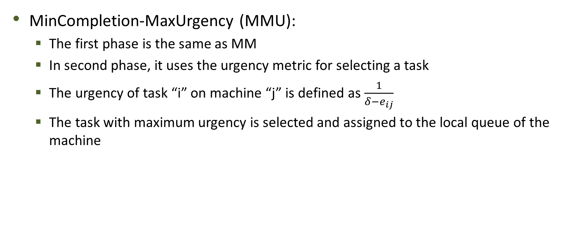
Baseline Mapping Heuristics
MinCompletion-MaxUrgency (MMU):
The first phase is the same as MM
In second phase, it uses the urgency metric for selecting a task
The urgency of task “i” on machine “j” is defined as $\frac{1}{δ−e_{ij}}$
The task with maximum urgency is selected and assigned to the local queue of the machine

Slide 23
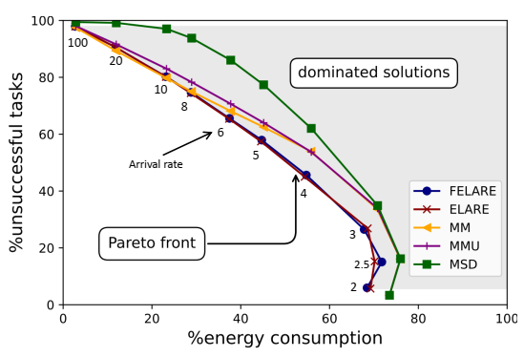
Energy vs Latency: Trade-off in a Bi-Objective Optimization
At high arrival rate all methods exhibits similar
The system is highly oversubscribed and tasks are missed regardless of the mapping heuristic
However, the proposed heuristics, dominate other heuristics at lower arrival rates

Slide 24
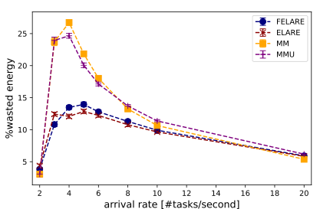
Analyzing Wasted Energy
Wasted energy is due to processing infeasible tasks
the wasted energy is the percentage of energy consumed by machines to process the missed tasks with respect to the initial available energy of the HEC system
we used 30 synthesized workload traces with different arrival rates with 2,000 tasks

Slide 25
Analyzing Wasted Energy
We observe that the wasted energy for ELARE and FELARE at low to moderate arrival rates is much less than the other heuristics
For the high arrival rates, all the heuristics converge to a low energy wastage
At high arrival rates, most of the tasks become infeasible there is no chance to make them feasible
Hence, they miss their deadline before even being assigned, regardless of the mapping heuristic being used

Slide 26
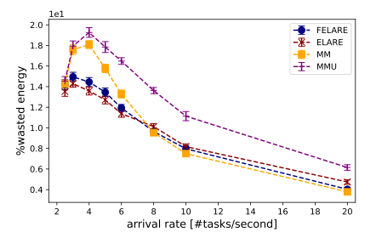
Analyzing Wasted Energy
Similar trend is observed when the deep learning applications are executed on the AWS instances

Slide 27
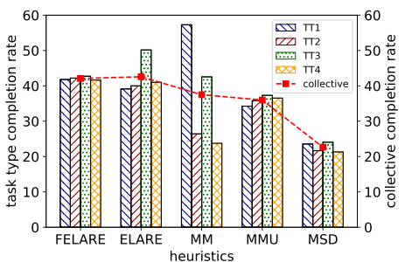
Analyzing Fairness Across Task Types (Synthesized Workload)
Arrival rate of 5 tasks per second totally 2000 tasks
Collective completion rate is the ratio of the successfully completed tasks to the total number of tasks that has arrived to the system
We observe that ELARE is biased towards T3 and MM towards T1 and T3
FELARE could considerably improve the fairness with negligible degradation in the total completion rate

Slide 28
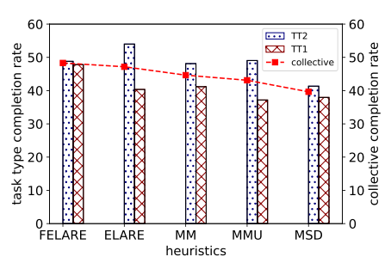
Analyzing Fairness Across Task Types (ML Workload on AWS)
Arrival rate of 2 tasks per second
The FELARE method exhibits substantially higher fairness than the other heuristics

Slide 29

Edge to Cloud (E2C) Simulator Demo
https://github.com/hpcclab/E2C-Sim

Slide 30
Conclusion
We investigated the fair and energy-efficient allocation of concurrent and latency-sensitive ML applications in HEC systems
We proposed ELARE to address both energy and latency objectives
ELARE could considerably reduce the wasted energy via dropping infeasible tasks and choosing the machines with the minimum energy usage for each task
To address the fairness, we extended ELARE and proposed FELARE heuristic
it prioritizes the suffered task types in each mapping event
for an infeasible suffered task, FELARE drops tasks from the non-suffered types to make the suffered task, feasible
we showed that customized mapping heuristics for HEC can noticeably improve the fairness and energy consumption particularly for low to medium workload

